Slide 1
Mentoring and Coaching New Employee-Owners: A Co-Worker Perspective
Lea Belair, Coaching Center of Vermont
Bob Correll, PC Construction
Notes:
Today we are going to focus on how ESOPs succeed because our people think and act like owners – and how mentoring and coaching are vehicles to making that happen in peer-to-peer relationships.

Slide 2
Outline
Development at PC
Mentoring
Coaching
Practice!
Your input
Wrap up
Notes:
Today we are going to focus on how ESOPs succeed because their people think and act like owners – and how mentoring and coaching are vehicles to making that happen in peer-to-peer relationships.

Slide 3
PC Construction Company
Formerly Pizzagalli Construction Co.
ESOP started in 2001 at 30% employee-owned
Progressed to 80% in 2007
100% employee-owned in April 2009
Headquartered in South Burlington, Vermont

Slide 4
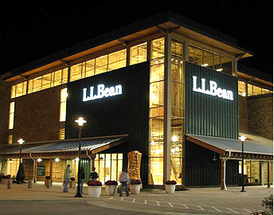
PC Construction Company
One of the largest Employee-Owned Contractors in the US
General Contracting
Construction Management
Design/Build Services
Private and Public
Projects of all sizes

Slide 5
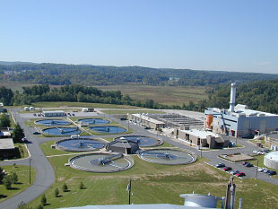
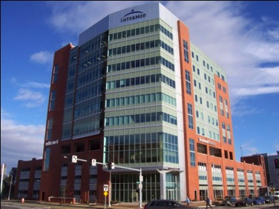
PC Construction Company
Operations from Maine to Georgia
Water Treatment division
Water Treatment Plants
Wastewater Treatment Plants
Buildings & Facilities division
Education, Energy, Health Care
Hospitality, Commercial, Special Projects
Manufacturing & Industrial

Slide 6
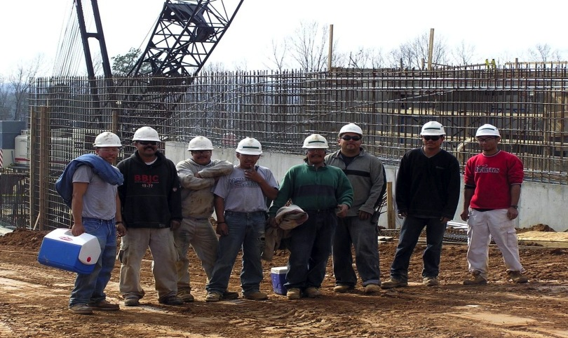
PC Construction Company
Current workforce just over 700
275 + administrative employees
440 + field employees

Slide 7
Building a Case for Development
Notes:
A large amount of your retirement fund value is in company stock
You can’t “sell” your company stock until you leave the company
The more valuable the company is when you leave the company (retire), the more money you’ll have in your retirement fund
The only way to make the company valuable when you retire is to have a ready workforce.
Lea will talk to us about Mentoring and Coaching, two of our most effective tools for development.

Slide 8
Mentoring vs. Coaching

Slide 9
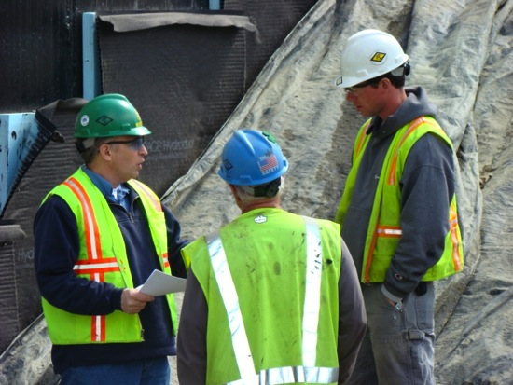
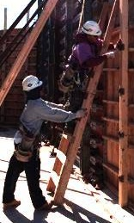
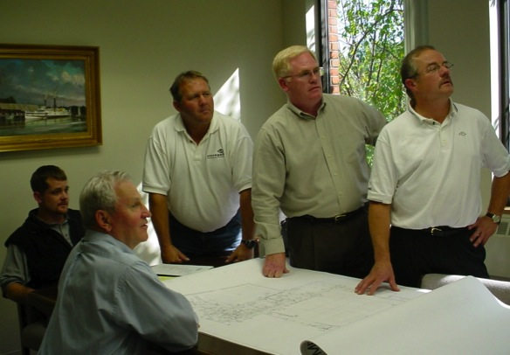
Mentoring at PC
Notes:
I asked some employees, “How does being an ESOP affect the way that you develop other employees?”
Accountability - “Hey, you’re affecting my stock price!”
Cooperation – “If it helps you, it helps me.”
Thriftiness – “Is this really worth it? Because we’re all buying it.”

Slide 10
PC’s Formal Mentoring Program
Initiated from the top
Pilot program
Begin with Executives as mentors
Mentors assigned to high-potentials in different branches of the organizational tree
Limited time period
Review at the end

Slide 11
PC’s Formal Mentoring Program
What have we learned so far?
Mentors are excited but anxious.
Mentors do not know what is expected of them, or the difference between mentoring and coaching.
Mentors have a hard time connecting without structure.

Slide 12
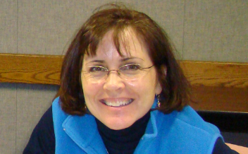
Mentoring at PC
“Working at an ESOP company is like being on a team where you contribute to shared success. As a manager at an ESOP company, it’s easier to talk to my direct reports on the benefits of caring about the success of not only our projects, but our coworkers projects as well…”
- PC Project Manager
Notes:
“Being in an ESOP allows us to consider how we spend our overhead dollars. In a non-ESOP company, those decisions are made by others and employees have little cause to consider those expenses”
Mentoring is a great way to accelerate an employee’s development, by showing the ways it’s been done before and the actual results. However, mentoring has it’s limits. In it’s strict sense, mentoring only develops an employee to the level of the mentor. There’s another tool, however, that can be used to slingshot the employee past.

Slide 13
Coaching at PC
Hired the Coaching Center of Vermont
www.CoachingCenterOfVT.com
Use Coaching for Great Work by Box of Crayons
www.CoachingForGreatWork.com
www.BoxOfCrayons.biz

Slide 14
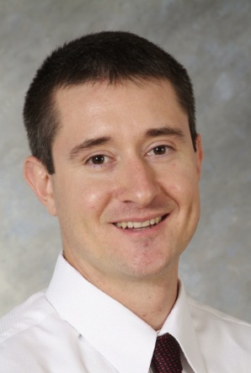
Coaching at PC
“…the end result is an individual who is held accountable for their decisions and the agreements they make, becomes a self-starter and enjoys personal success with their working experience while building a sense of ownership to a common objective.”
- PC Senior Project Manager

Slide 15
Coaching
B
?
B
A
Visionary Leader Model

Slide 16
Practice!

Slide 17
Coaching at PC - PDMs
Restructuring our Performance Development Meeting forms as a coaching tool
Review previous goals
Establish new goals using Position Descriptions as a baseline “B”
Focus on behavior
Who, What, When, and How but not Why

Slide 18
Coaching at PC - PDMs
What have we learned so far?
Some managers really get it.
Many managers have a very difficult time being a coach and need additional training and continuous feedback.
It is much more effective to teach the manager to coach than to try to coach all of direct reports.

Slide 19
Questions?

