Slide 1
Sharing Financial Information with Employee Owners
June 8, 2012
Victor Aspengren
Prairie Capital Advisors, Inc.

Slide 2
The Purpose Of A Business
MAKE MONEY
SELL THE BUSINESS
RELATIONSHIPS ARE ADULT TO ADULT
IMPROVE EMPLOYEE’S LIVES

Slide 3
Barriers To Good Business
People do not feel safe
Lack of trust
Poor communication
Not understanding the numbers of business
Lack of education/training
The blame game
Gossip

Slide 4
Joys Of Business
Feels like family
Great friendships
Share in ownership
Personal growth
Having fun

Slide 5
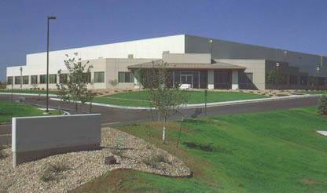
Where Would You Invest
Just a job…..
People think, act and feel like owners

Slide 6
What Open Book Is
Every Employee
is given the measures of business success and taught to understand them
is expected to use their knowledge to improve performance
has a direct stake in the company's success

Slide 7
What Open Book Is Not
Program-of-the-Month
Total disclosure
Rigid formula
Entitlement
Equity

Slide 8
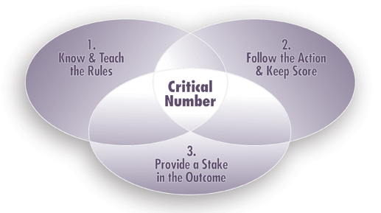
The Great Game of Business Model

Slide 9
The Great Game of Business
Critical Number – Operational or financial number that represents a weakness or vulnerability that if not addressed and corrected will negatively impact the overall performance and long-term security of the business.
It is a weakness or vulnerability, measurable, performance yardstick and a rallying point.

Slide 10
The Critical Number
Choose the Critical Number
Default first critical number is Profit!
What does winning mean in the next 6 to 12 months?
What will greatly impact business success or sustainability?
Set the improvement target
What is the desired outcome?
Reasonable and achievable?
Too complex? Is it clear and understandable?
Will it provide an early WIN?
Will it cause any unintended consequences?

Slide 11
The Critical Number
Find the Right Drivers – The Key Drivers
What will drive the CRITICAL NUMBER?
What will greatly impact the desired outcome?
Why? 5x
Begin to forecast/predict the outcome?
Place a Mini-Game on the Key Driver
30 to 90 days
Other considerations
Educational?
How much influence does the team have over it?

Slide 12
Practices of the Game
Know & Teach the Rules
High Involvement Planning
Business Literacy (formal approach)
Follow the Action & Keep Score
Scoreboards
Huddling
Provide a Stake in the Outcome
Recognition
Mini-Games
Annual Incentive Plan
Employee Ownership

Slide 13
Follow The Action & Keep Score
Develop a score card, they are used to track, measure, and report key operational financial numbers. They can be work group, department, division, corporate.
This encourages goal setting, mutual accountability, performance management
Keeps the players involved, motivated, and focused.

Slide 14
Develop a simple Scorecard
Corporate Scorecard
Line of Sight
Department Scorecard
Workgroup Scorecard
Income Statement
Revenue
Sally’s Scorecard
Purchasing
Materials
Expenses
Price Variances
Materials
Price Variances
Profit (loss)
Product XYZ

Slide 15
The Huddle
Weekly Huddle
30 minutes
Consistent reporting format so people know what to expect
Atmosphere
Controlled by chairperson
Learning is emphasized
Questions encouraged, gripes/complaints discouraged

Slide 16
Bonus Plan
Tied to improving the value of the business
Understandable
Educates employees and changes behaviors
Enhances standard of living
Achievable, but is a stretch
Frequent payout and regularly communicated
Self-funded
Encourages teamwork (places competitor outside the business)
Shared targets (Win or lose together as a team)
Mindful of cash flow and business fluctuations

Slide 17
Bonus Plan
10-20-30-40 Quarterly Bonus
Period | Period Pay Out | YTD Pay Out
1st Qtr. | 10% | 10%
2nd Qtr. | 20% | 30%
3rd Qtr. | 30% | 60%
4th Qtr. | 40% | 100%

Slide 18
Developing Mini-Games
Choose the game
Participants define the target
Set the improvement goal
Determine the timeframe
Participants decide on the prize
Develop a theme and design the scoreboard
Play the game
Celebrate the win

Slide 19
Potential Mini-Game Targets
Billable hours Production man hours
Product yield Average collection days
Re-work Inventory accuracy
Scrap Work-in-progress
Sales/gross margin On-time delivery
New customers Reducing overhead
Recruiting Average sales
Customer satisfaction Labor efficiency

Slide 20
Sample Mini-Game Scoreboard for the Ups & Downs Sales Department
Additional Sales
Daily
Month
-
To
-
Date
of Neon Yellow
Yo
-
yos
Goal
Actual
Goal
Actual
Week 1
Week 2
Week 3
Week 4
Total

Slide 21
Checklist for a Good Mini-Game
Establish clear line of sight
Rules are clear & simple
Easily measured & scored with a simple, meaningful scoreboard
Scorekeeper to settle disputes
Incorporate business training to aid understanding reasons for change
Frequent scoring for constant reinforcement
Competition against the problem, not each other
Scoring rewards positive outcomes, rather than penalty scoring

Slide 22
Benefits Of Sharing Financials
Improves trust & creates a common language
Stronger feelings of ownership
Facilitates communication
Intelligent decision making
Breaks down barriers
Reasons behind the actions
Encourages involvement

Slide 23
Contact Information
Victor Aspengren
Prairie Capital Advisors, Inc.
vaspengren@prairiecap.com
www.prairiecap.com
515-689-5969

